Slide 1

MEDSPACE
MEDSPACE
1 . AVNI MEHTA
2. MADHURI GUMMA
3. SINDHU MUDIREDDY
4. SUDHEESHA

Slide 2
INTRODUCTION
MedSpace is an android based application which makes the patient’s life easy to take an appointment and communicate with the doctor.
The main goal of this application is to provide the ease environment for the patient to interact with the doctor.
In this app both Patients and Doctors can signup their details.
Doctors will provide the details with their available timings and patients will enter their personal details and health condition.

Slide 3

FEATURES
Booking an appointment with doctor according to the doctor’s availability.
Patient can chat with doctor and have diagnosis from his own place.
Patient is able to make a video call with doctor.
Patient can search for doctor and according to his health condition(Ex: Dentist, Gynecologist, pediatrician, etc).

Slide 4

Application Flow
User ie., a patient or doctor can signup and login into the application with their details.
Doctor can check the patient’s requests.
Patient can book an appointment with the doctor by the choosing the doctor according to the problem he have.
Patient can chat or make a video call with the doctor and can have an efficient conversation with him.

Slide 5
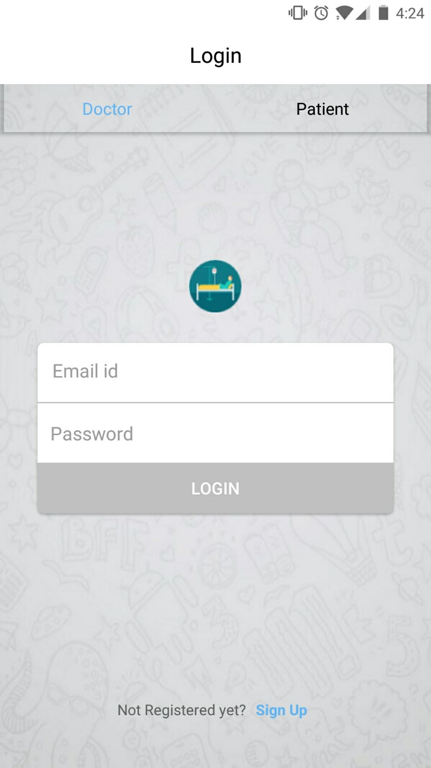
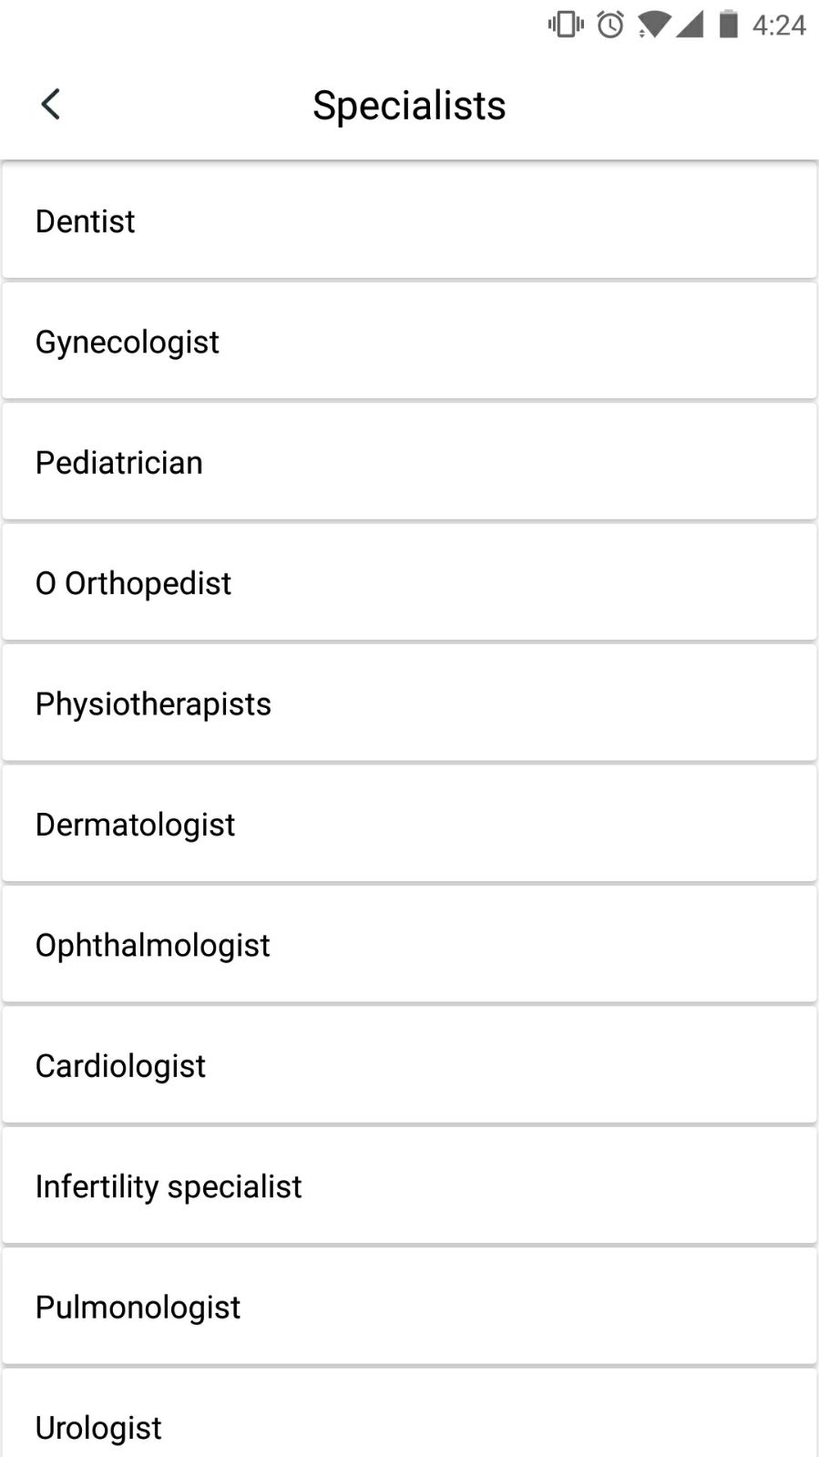
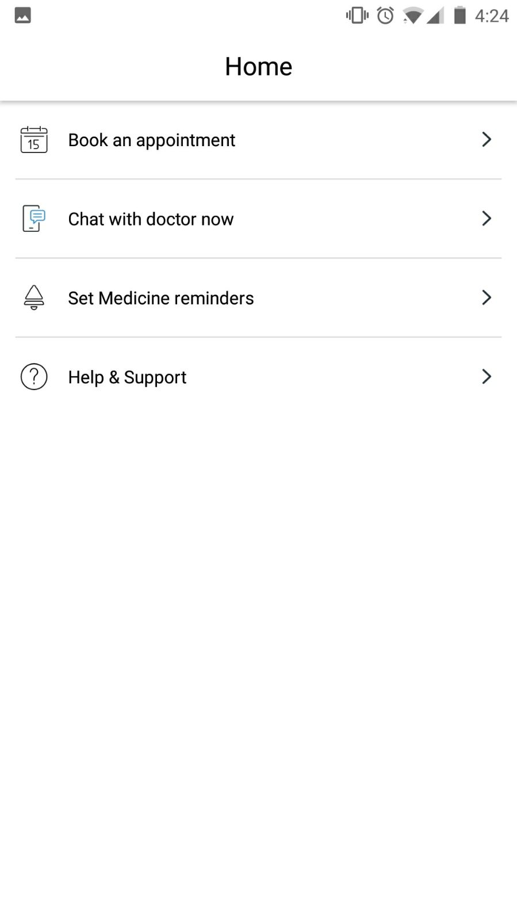
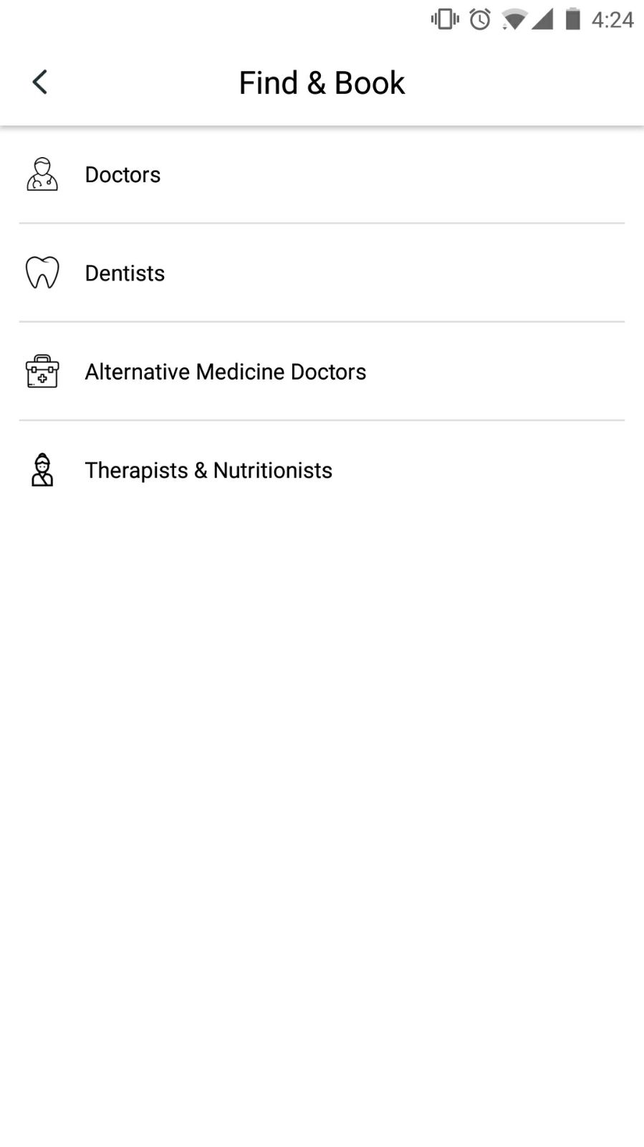
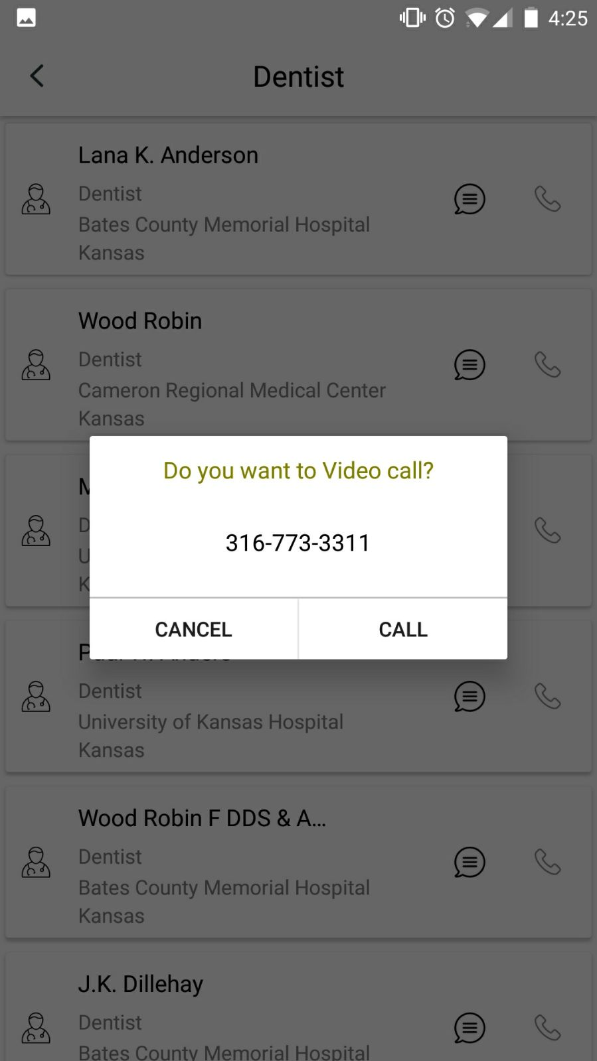
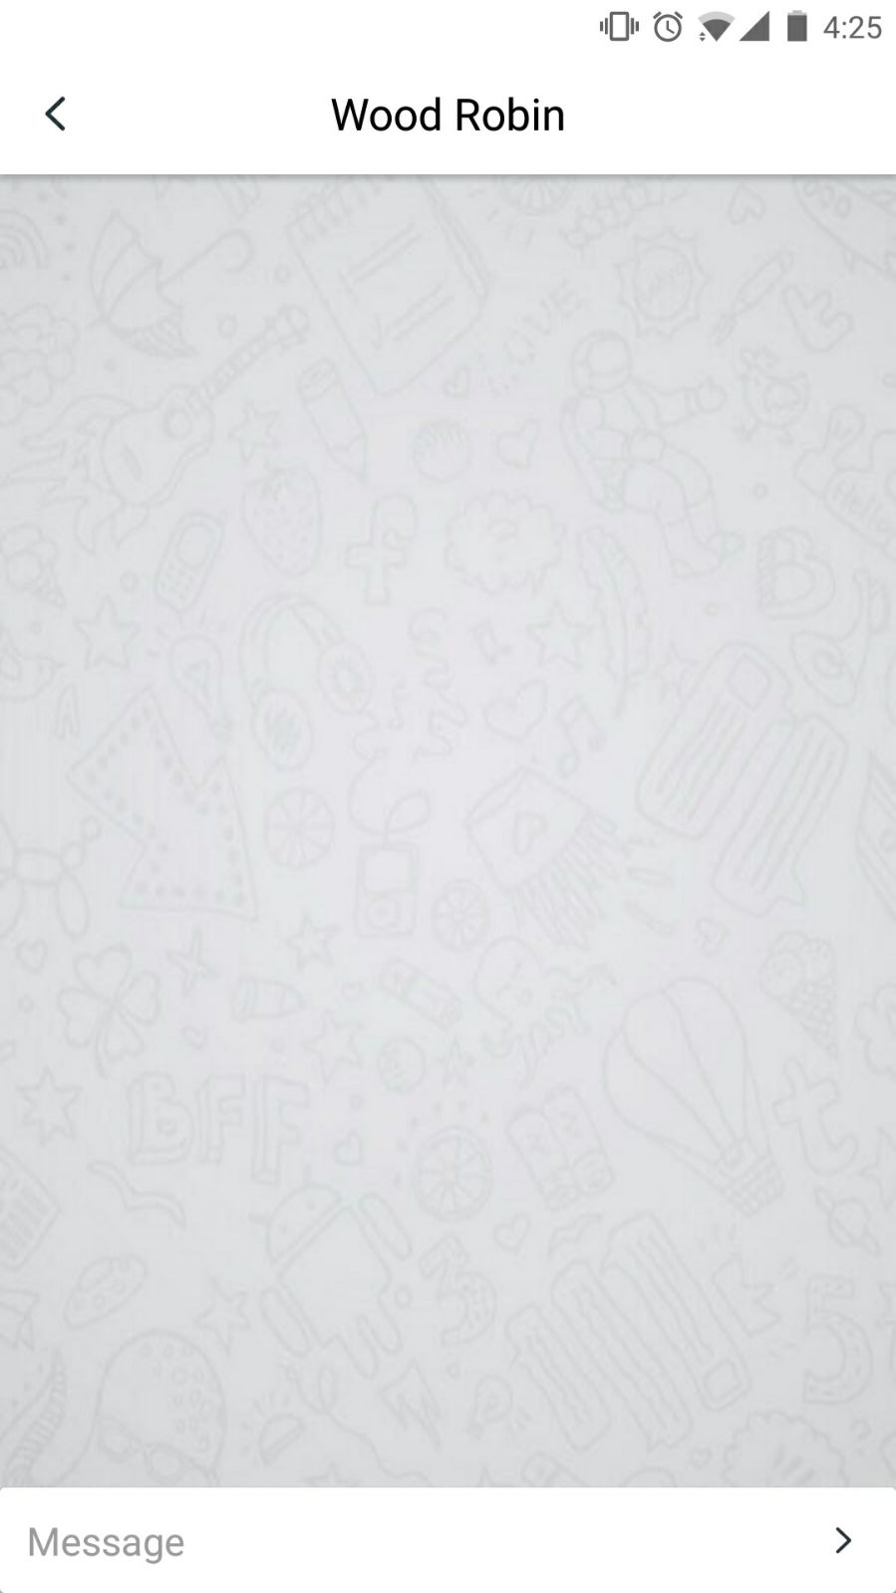
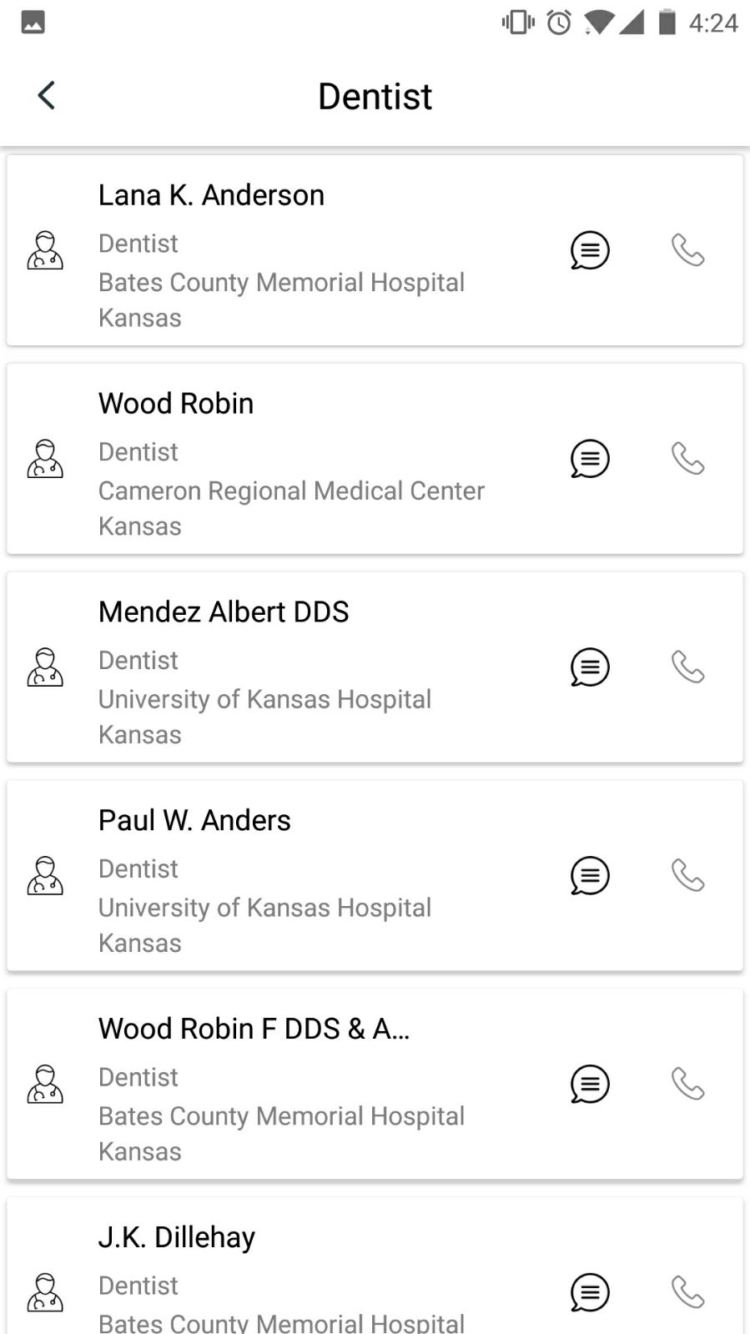

Slide 6
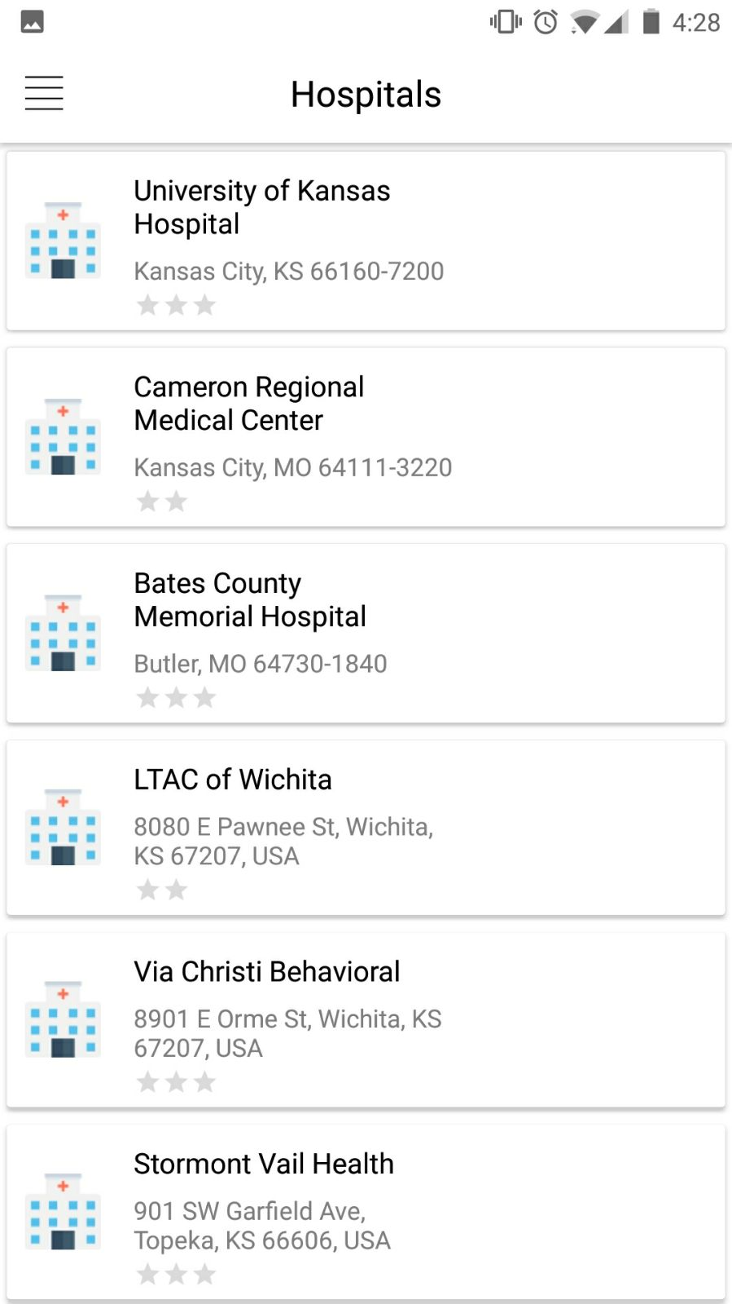
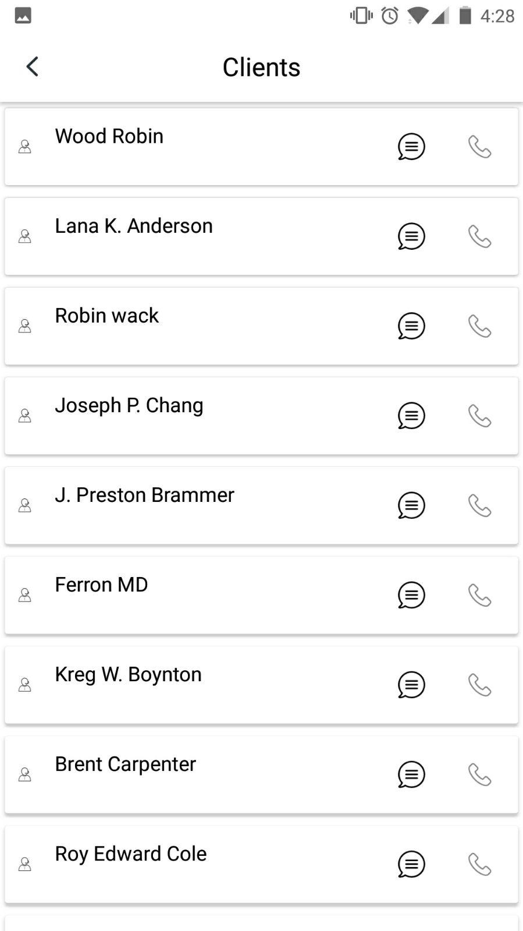
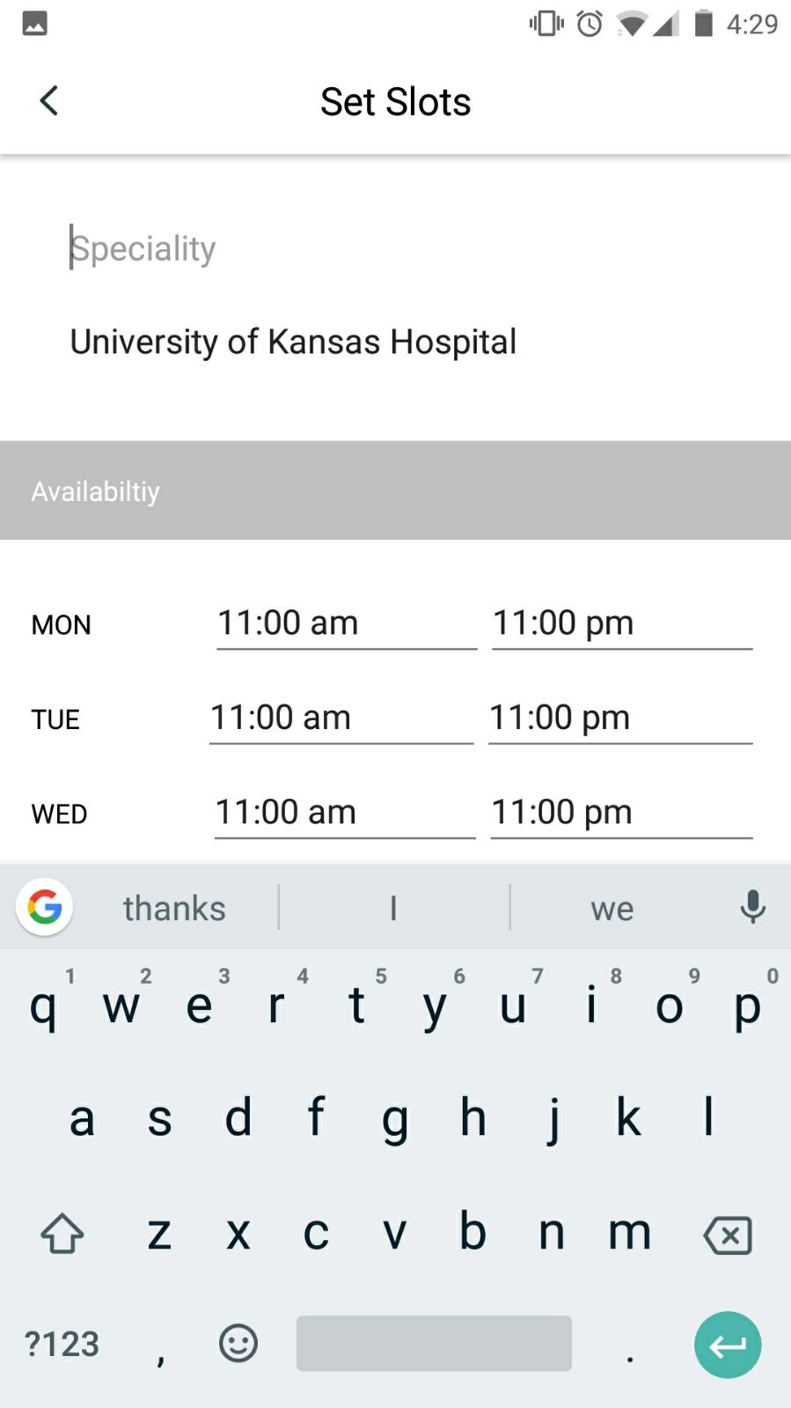
Doctor application flow

Slide 7
Thank You

